Slide 1
DUAL BAND FMCW RADAR CRITICAL DESIGN REVIEW
MATHIS BRAZEAL, ERIC EVANS, AND MARY KATHERINE WESSON

Slide 2
PRESENTATION AGENDA
Background
Project Recap
Power System
Radar Hardware
Signal Processing
Integration & Validation
Administration

Slide 3
PROBLEM STATEMENT
As water scarcity becomes a global environmental issue, the management of efficient water usage is becoming increasingly important for farming and agriculture
There is a need for a remote sensing device that can accurately measure soil moisture over large areas efficiently and eco-friendly

Slide 4
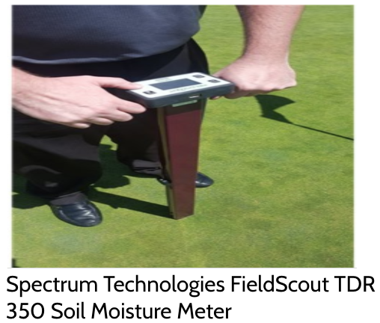
EXISTING SOLUTIONS
Soil Moisture Meters
Higher end models are expensive
Lower end models may return vague measurements (Low, Med, High)
Requires physical contact with the area being measured
Readings are for a small area
May possibly require environmental damage such as uprooting plants

Slide 5
PRESENTATION AGENDA
Background
Project Recap
Power System
Radar Hardware
Signal Processing
Integration & Validation
Administration

Slide 6
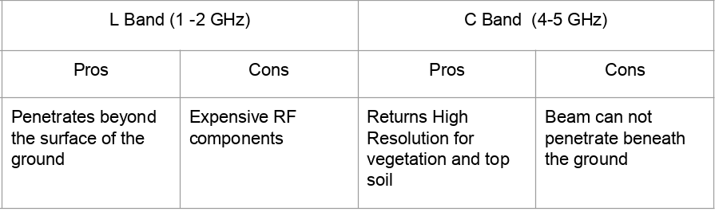
PROPOSED SOLUTION
Design and build a low cost dual band FMCW radar with Ground Penetrating capabilities to measure soil moisture
Why radar?
GPR can find underground features due to the measurement of reflections from EM waves.
Why dual band?
What size measurement area?
Based on a height of 1meter and our antennas’ beamwidth a single measurement would be:
Horizontal distance = 1.08 meters
Vertical distance = 1.69 meters
Area = 5.73 square meters
Multiple measurement would be used to get a larger reading and increasing the height of the antennas would increase this size
Notes:
These questions need to be answered

Slide 7
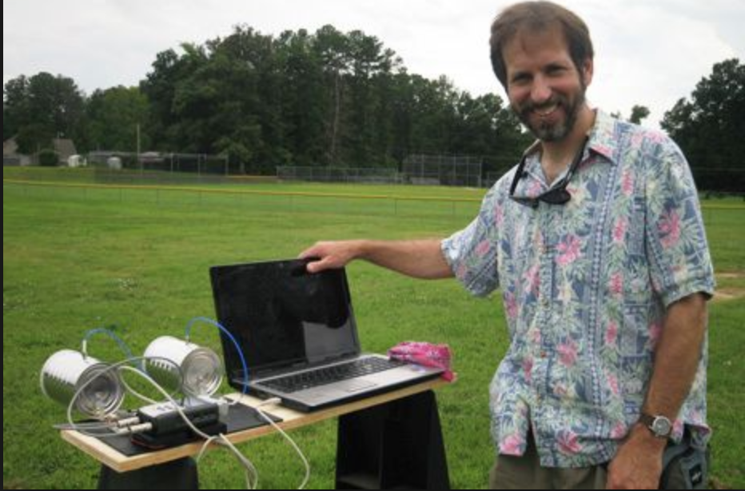
DELIVERABLES
Dual Band FMCW Radar
Top Soil sensing applications
Ground Penetrating applications
Soil moisture mapping
Easy to use GUI
Documentation

Slide 8
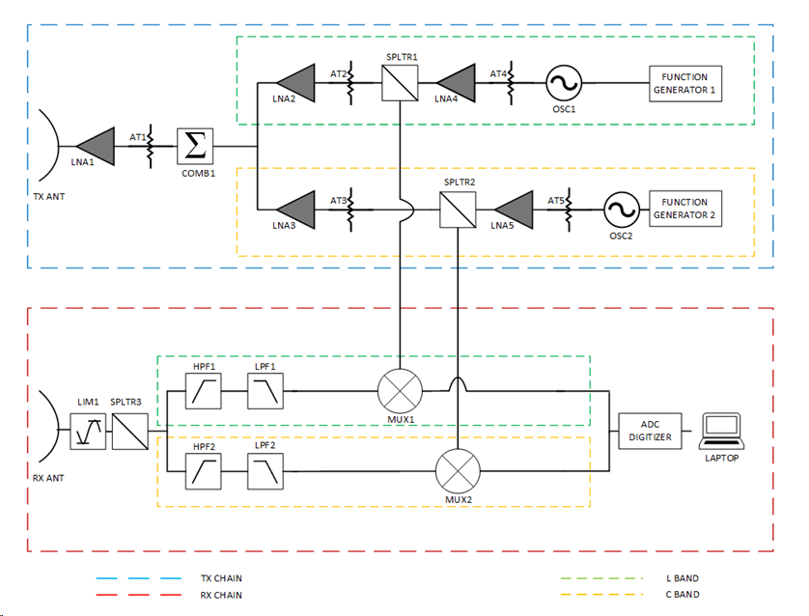
BLOCK DIAGRAM

Slide 9
PRESENTATION AGENDA
Background
Project Recap
Power System
Radar Hardware
Signal Processing
Integration & Validation
Administration

Slide 10
DESIGN
Two battery packs each 12V
Two linear voltage regulators
Both regulator supplied 5 V
One powerers the modulator circuit along with the VCO
Other powers the video amplifier circuit
Added heat sinks to avoid overheating
Each regulator is stepping down 12V from battery to 5V
Each circuit is drawing .07 A and .09A respectively
Corrcet amount of power being drwan by circuits
iwhen compnents are fried they draw more like two amps
So 7V is multiplied by each curent for the respectively power drawn
Leads to .49 W and .63 W respectively

Slide 11
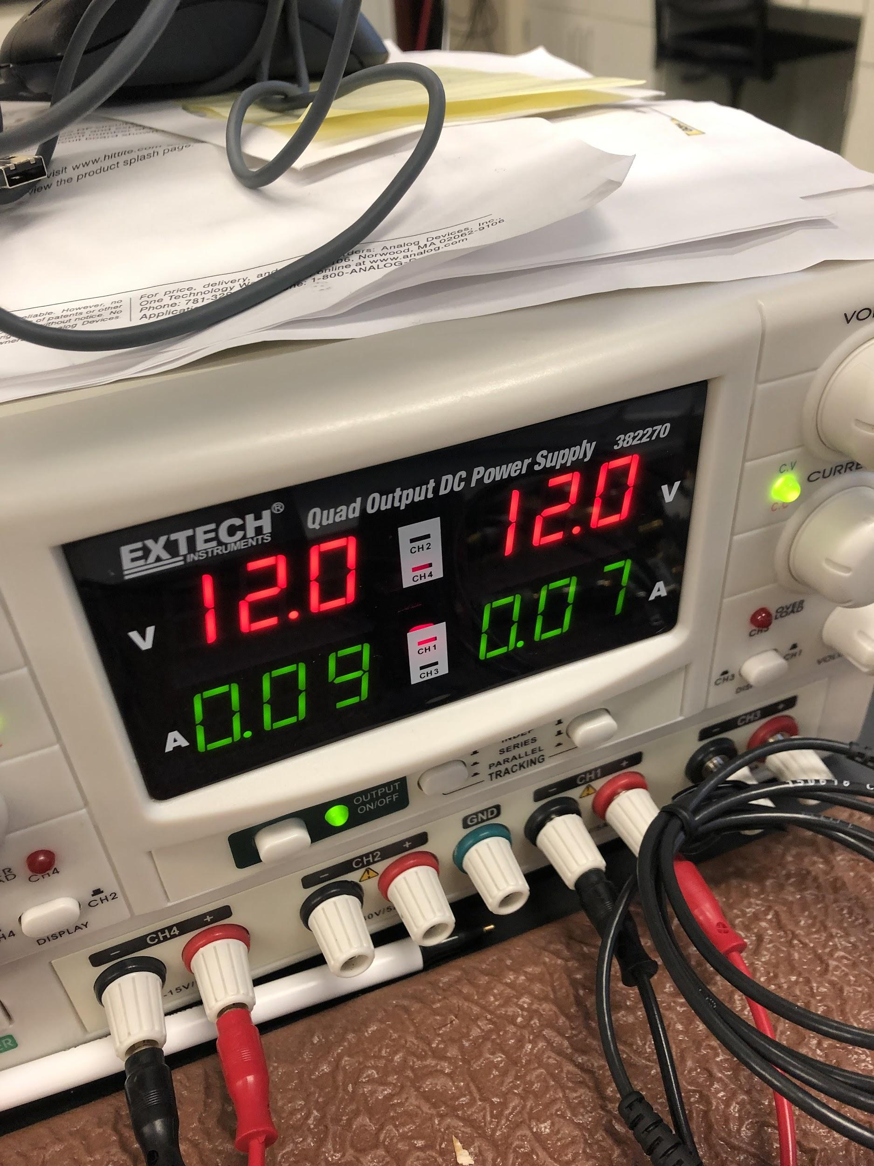
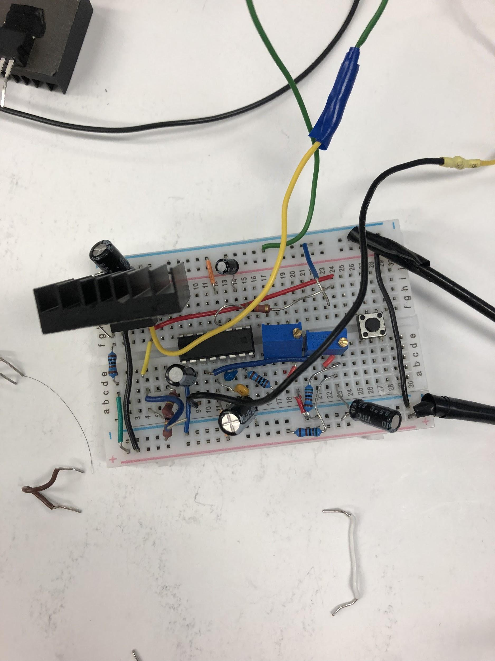
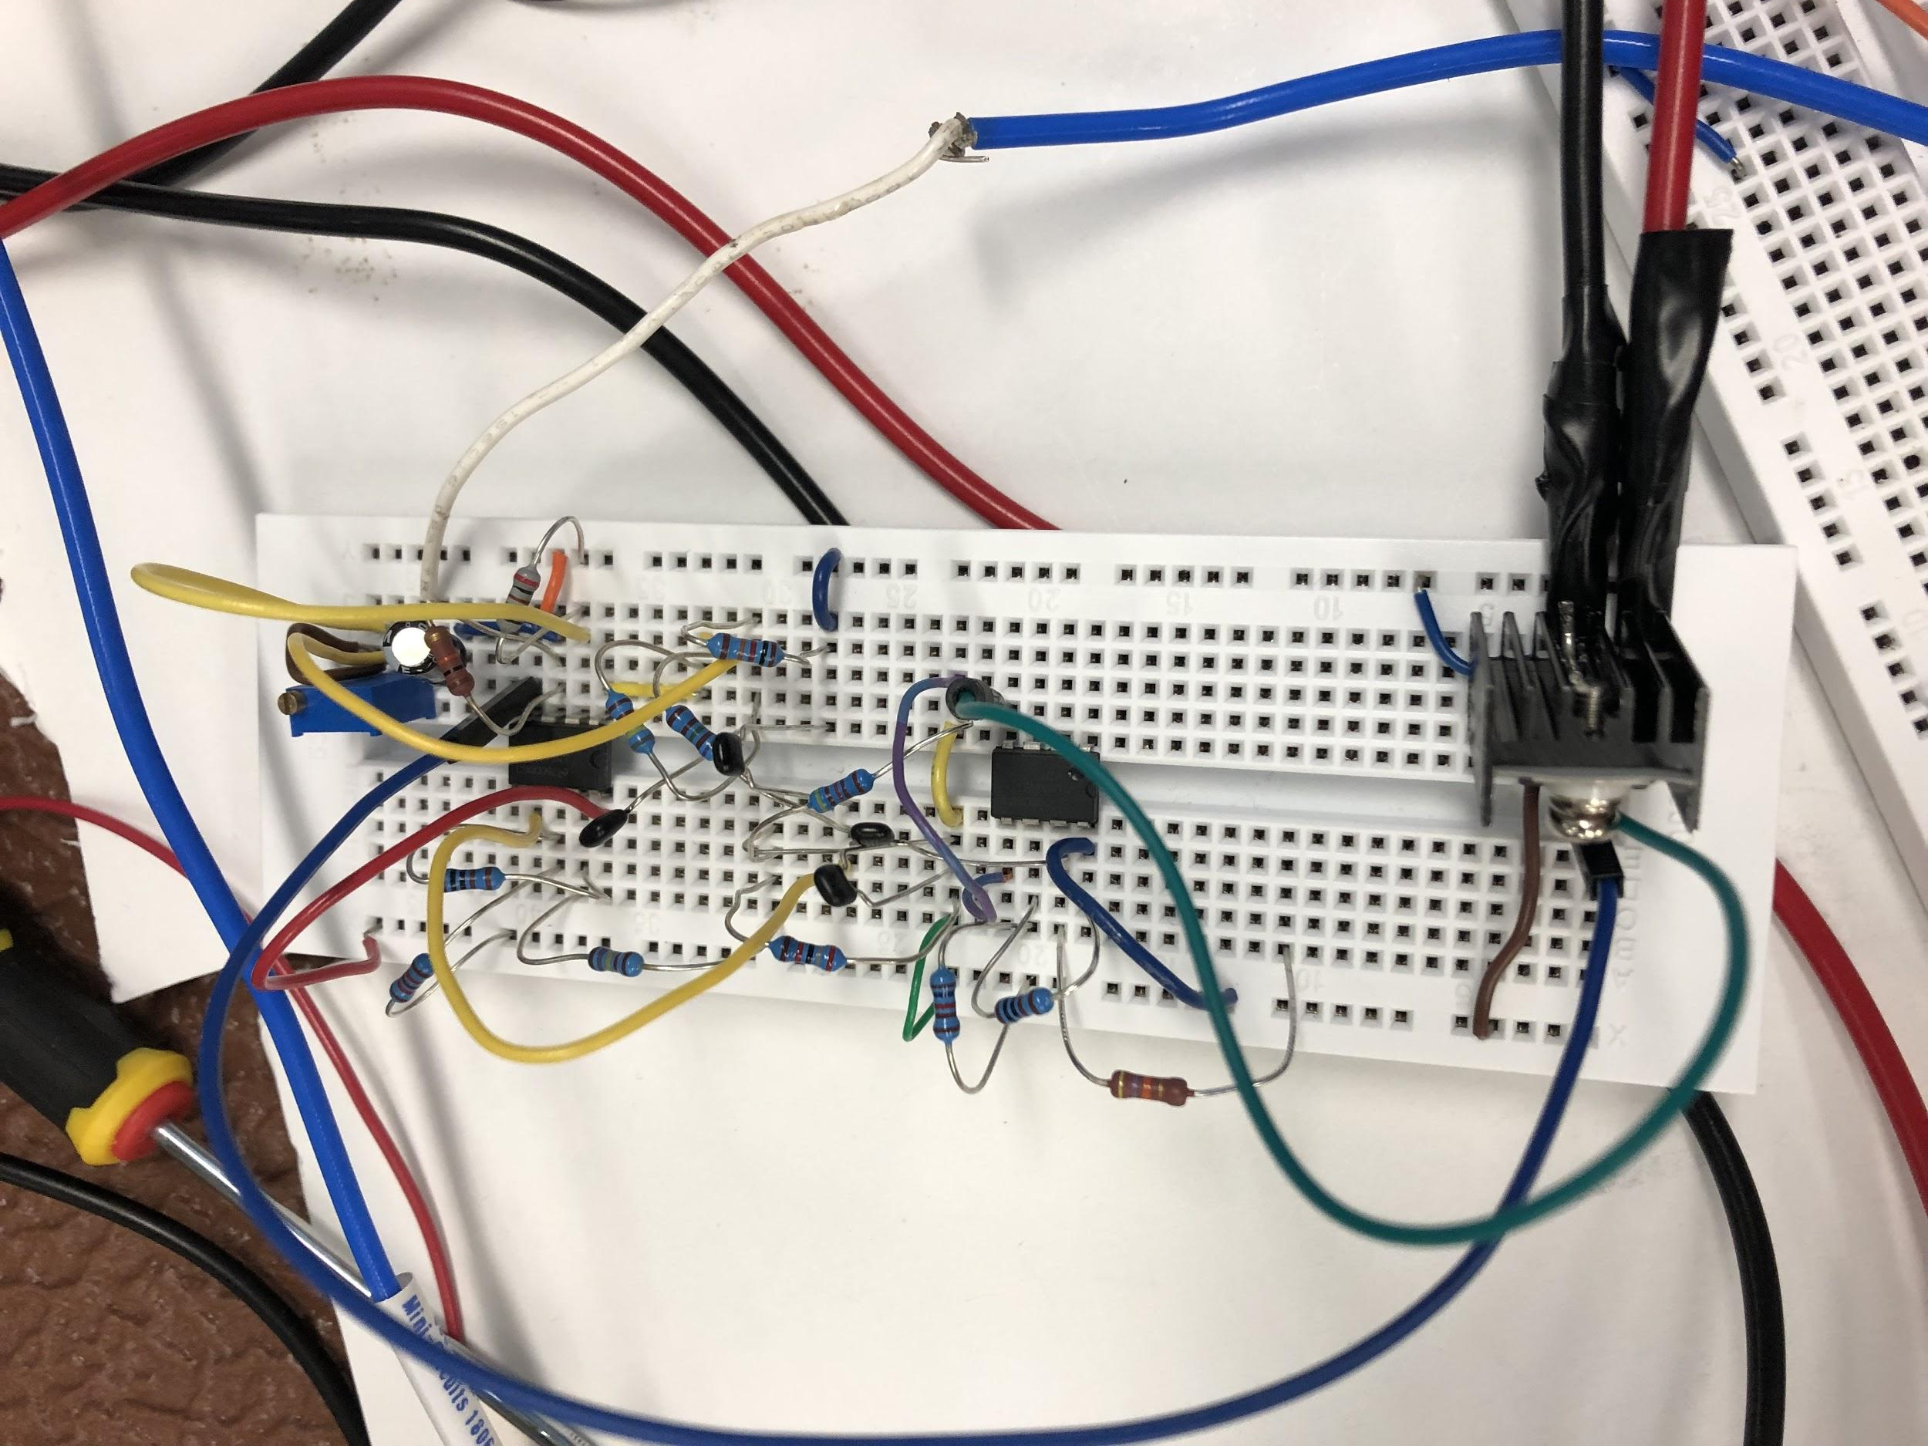
SUBSYSTEM VALIDATION
Two battery packs each 12V
Used Quad DC Power Supply
-tested power at 12 V
rating of batteris
showed current being drawn

Slide 12
PRESENTATION AGENDA
Background
Project Recap
Power System
Radar Hardware
Signal Processing
Integration & Validation
Administration

Slide 13
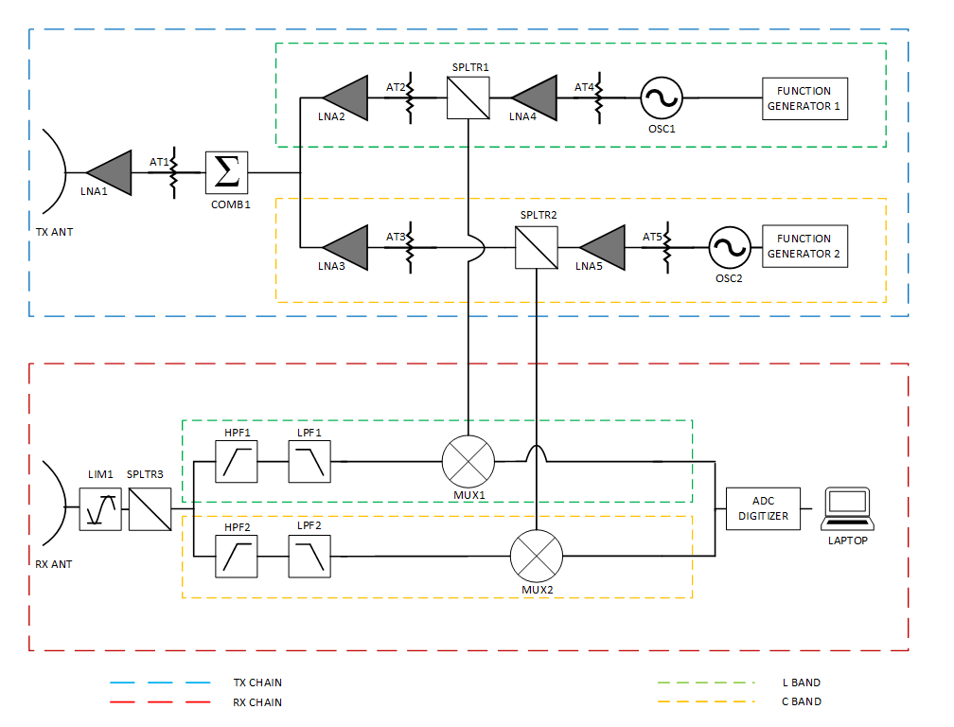
TRANSMIT CHAIN DESIGN & OPERATION
The Voltage Controlled Oscillator (OSC1 / 2) drives the programmed frequency to the transmit antenna.
The low noise amplifiers and attenuators increase the signal power at transmit
The Splitters (SPLTR 1 / 2) will split those corresponding signals to the receive chain individually.
Both Signals are combined by the Combiner (COMB 1) and the signal power is further boosted due to the Attenuator (AT1) and Low Noise Amplifier (LNA 1).

Slide 14
RECEIVE CHAIN DESIGN
All signals up to 18 GHz are picked up by the receive antenna, but are then limited by the limiter (LIM1) and split into their respective frequency bands (L and C).
The signal is then further attenuated by high and low pass filters (HPF1 / LPF1).
High Pass Filter- Passes frequencies higher than the rated cutoff. Low Pass Filter - Passes frequencies lower than the rated cutoff.
Mixer - Mixes signals path with additional signal. Passes the sum of the returned signal with the transmitted signal.
ADC converter samples the frequencies and converts them to digital signals.

Slide 15
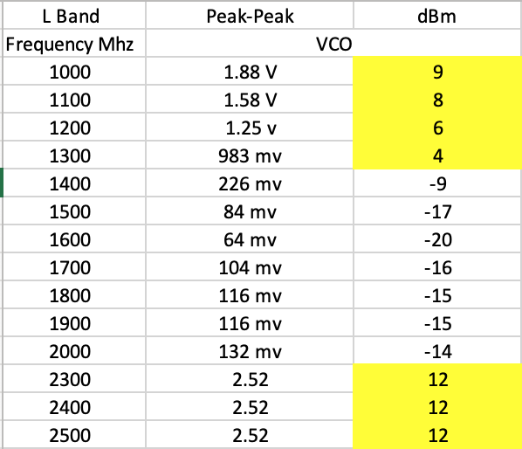
L-Band Transmit Frequency Output Power Readings
Frequency bands 1 - 1.3 Ghz yielded positive signal power
Frequency band 2.3 - 2.5 Ghz yielded strong signal power
We decided to narrow our band to 2.3 Ghz to 2.5 Ghz.
The VCO that gave us this rating was the ZX95-2536C-S+

Slide 16
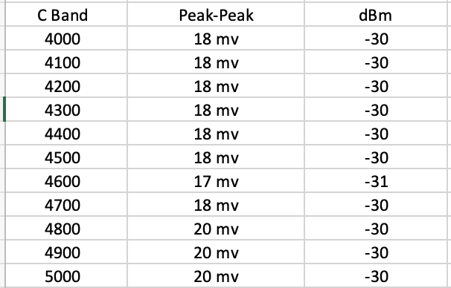
C-Band Transmit Frequency Output Power Readings
The C-Band transmit signal output power was very low and it would be too expensive to boost the power.
Converted peak- peak voltage to dBm for power measurements.
Decided to drop the C-Band all together.
L-Band works better than C-band for GPR.

Slide 17
SUBSYSTEM VALIDATION
Use soil moisture data to be compared with the processing of the remote sensor radar
Configure our software to our

Slide 18
PRESENTATION AGENDA
Background
Project Recap
Power System
Radar Hardware
Signal Processing
Integration & Validation
Administration

Slide 19
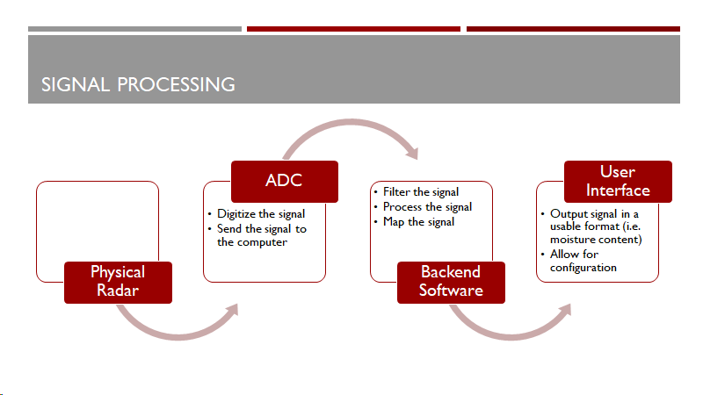
Notes:
•Read in a signal from the water molecules

Slide 20
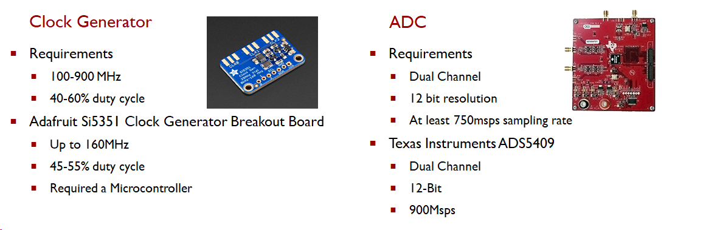
CLOCK & ADC

Slide 21
Backend Software
Filter the incoming signal
Bandpass hamming window filter
Put the signal through a variety of equations to estimate the backscatter
Backscatter coefficient = beam limited radar range equation / radar range equation for a point target
Map the backscatter estimate to known values
Measure the same area with both the radar and a high end contact probe
Map the backscatter values to the contact probe values

Slide 22
User Interface
Main user interface to run the system
Consists of a button to start the system and an output of the soil moisture reading
May contain graphics such as graphs or spectrograms
Configuration user interface
Allows the user to set up the system for their situation

Slide 23
UPDATES
Added a Arduino Mega to control the clock generator
Convenience and timing
Existing documentation
Moved two filters from hardware to software
Accessibility
Cost

Slide 24
SUBSYSTEM VALIDATION
ADC
Input a known signal
Verify output using lab equipment
Backend Software
Use the data from a Remote Sensing Center radar
Compare our processed output to theirs
GUI
Functional Testing
Non-functional Testing

Slide 25
PRESENTATION AGENDA
Background
Project Recap
Power System
Radar Hardware
Signal Processing
Integration & Validation
Administration

Slide 26
INTEGRATION PLAN

Slide 27
SYSTEM VALIDATION PLAN
Complete radar
compare moisture readings from radar with measurements from moisture probe

Slide 28
PRESENTATION AGENDA
Background
Project Recap
Power System
Radar Hardware
Signal Processing
Integration & Validation
Administration

Slide 29
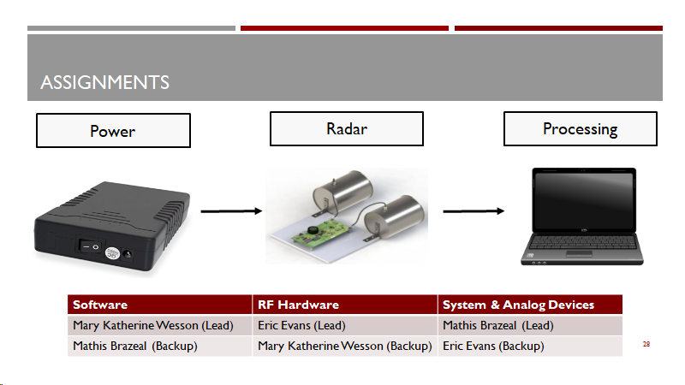
ASSIGNMENTS

Slide 30
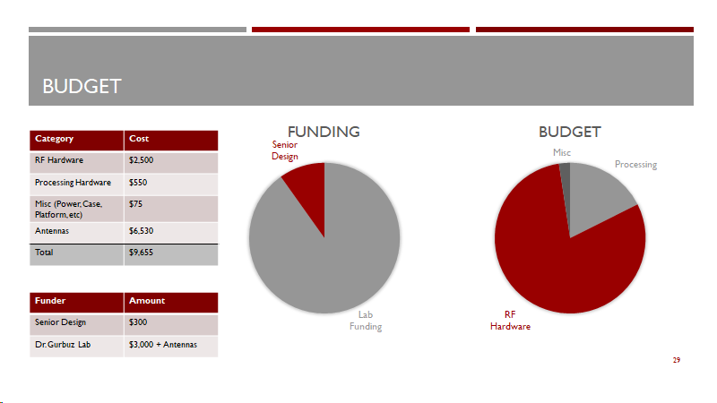
BUDGET

Slide 31
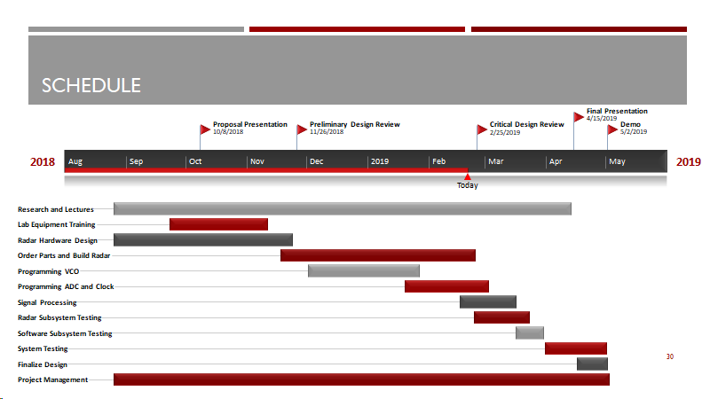
SCHEDULE

Slide 32
IMPACTS
Environmental Impacts
No drilling, probing or digging of landscape
Conservation of water usage
Societal Impacts
Time Efficient
Reduced physical activity

Slide 33
ACKNOWLEDGMENTS
University of Alabama, College of Engineering
Electrical and Computer Engineering Department
Remote Sensing Center
Dr. Gurbuz

Slide 34
QUESTIONS?

